Slide 1
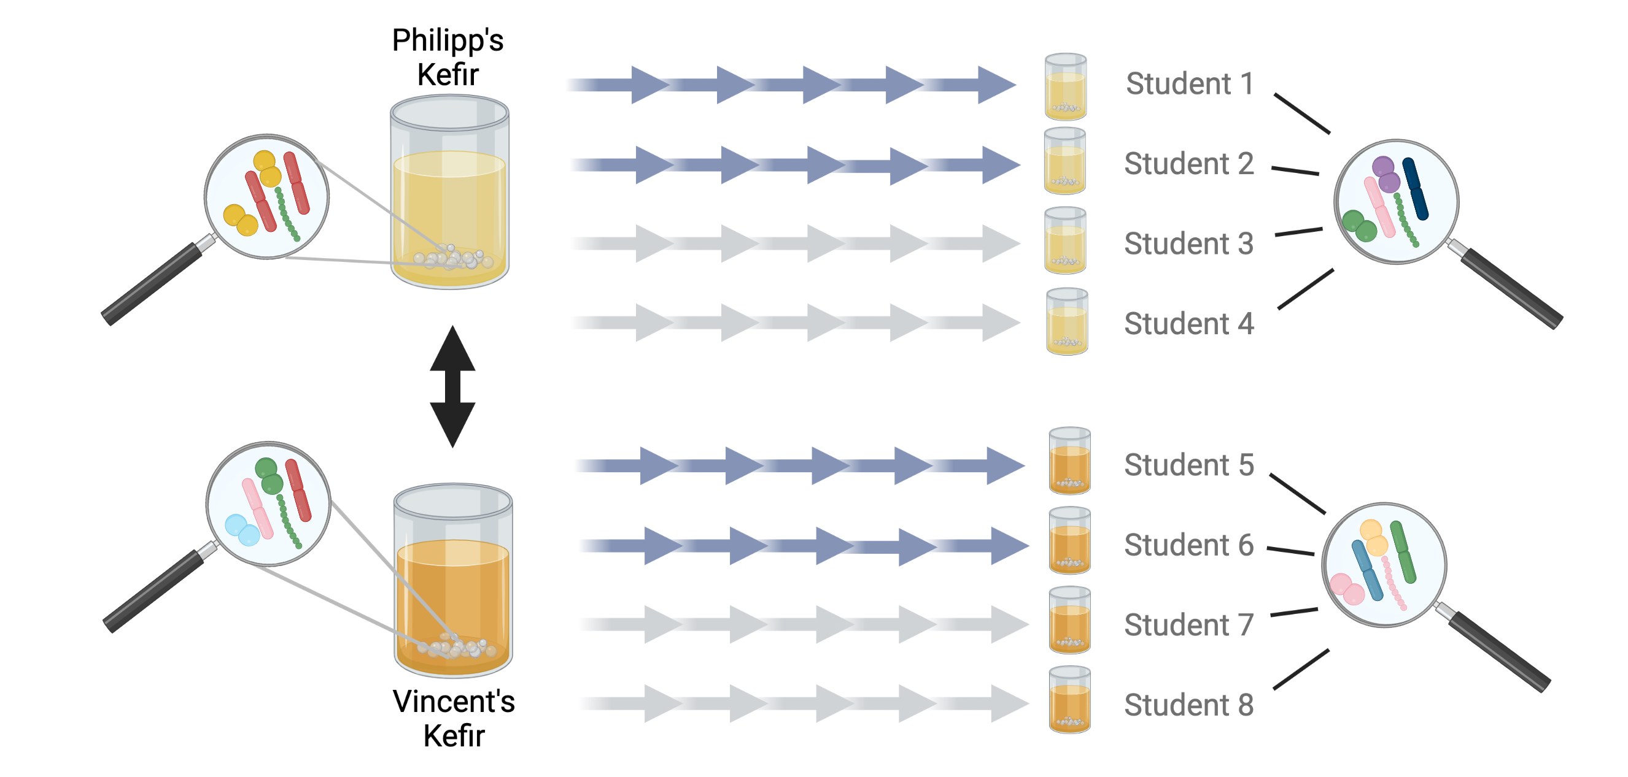
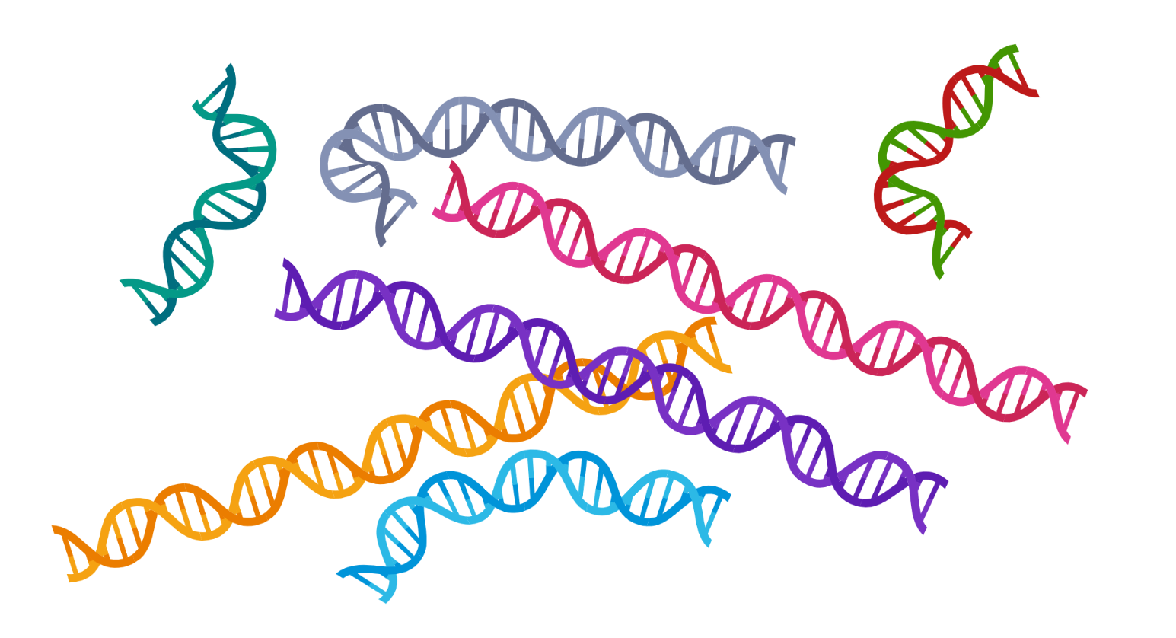
‘Sequence a Genome’ (SAGE II)
Master Molecular Life Sciences
(8th semester)
Department of Fundamental Microbiology, UNIL

Slide 2
‘Sequence a Genome’ (SAGE II)
Master Molecular Life Sciences
(8th semester)
Department of Fundamental Microbiology, UNIL
1.- The Species Matrix
2.- Alpha Diversity
3.- Beta diversity

Slide 3
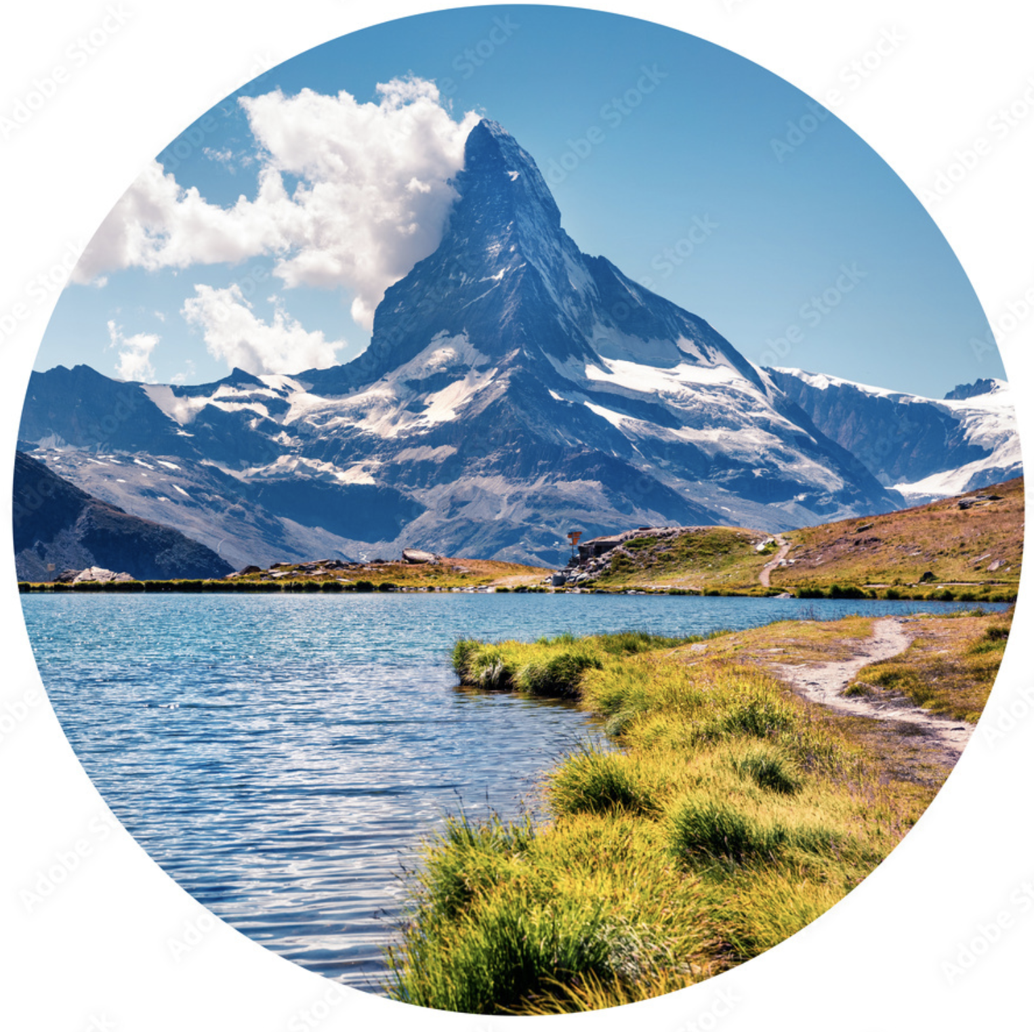
The microbiota of animals
The
Sites X Species Matrix

Slide 4
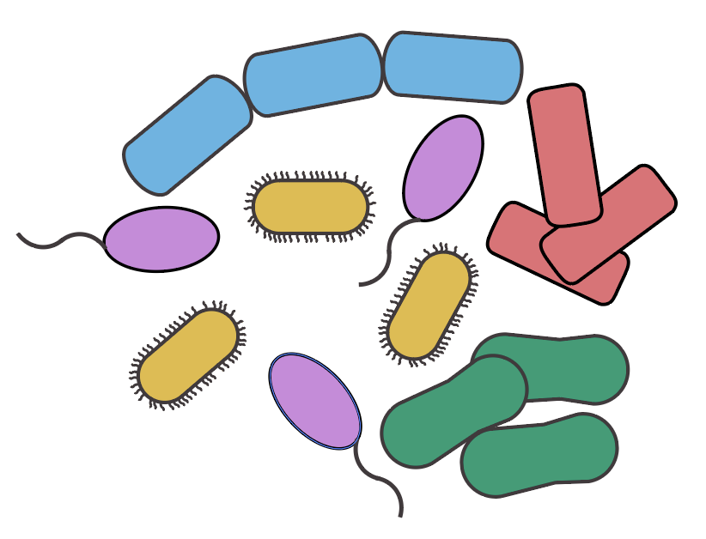
The microbiota of animals
Community Ecology
How many species?
How do they change the environment?
Why some ecosystems contain more species than others?
How are they affected by the environment?
How do they interact with each other?
A set of populations (individuals from different species)
coexisting in the same space and time
Community

Slide 5
The microbiota of animals
Community properties
Composition
Who is there?
Which species?
What types?
Structure
How many of them?
Abundant or rare?

Slide 6

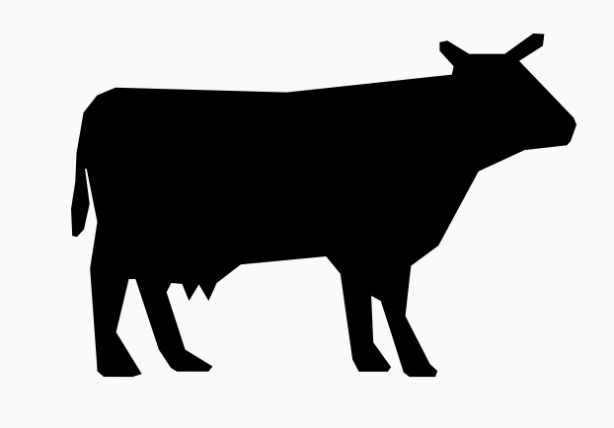


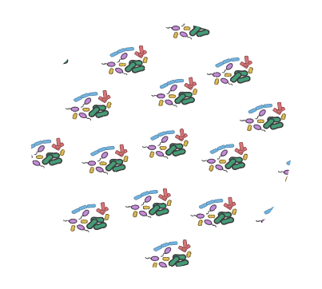
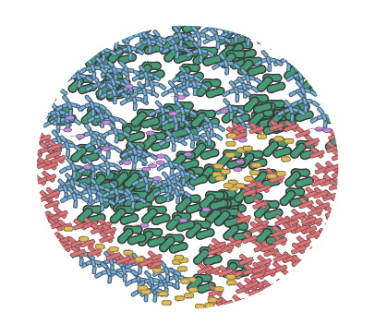
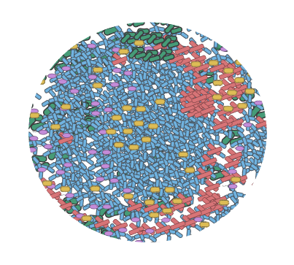
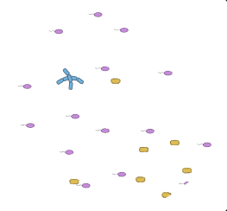
The microbiota of animals
Toy example: gut microbiota of mammals

Slide 7
The microbiota of animals
The Site x Species Matrix
SITES
Samples, Regions, Hosts
 | 0 | 0 | 250 | 100
 | 70 | 100 | 200 | 50
 | 4 | 100 | 250 | 600
 | 0 | 100 | 225 | 200
 | 20 | 100 | 200 | 50
SPECIES
COUNTS
OTUs
ASVs
Strains
Species
Individuals
Cells
Reads
Fluorescence
Biomass
Proportions

Slide 8
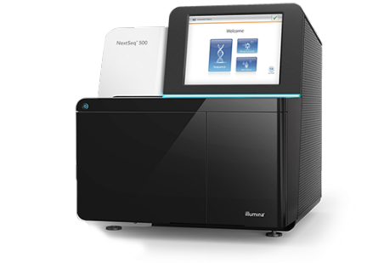
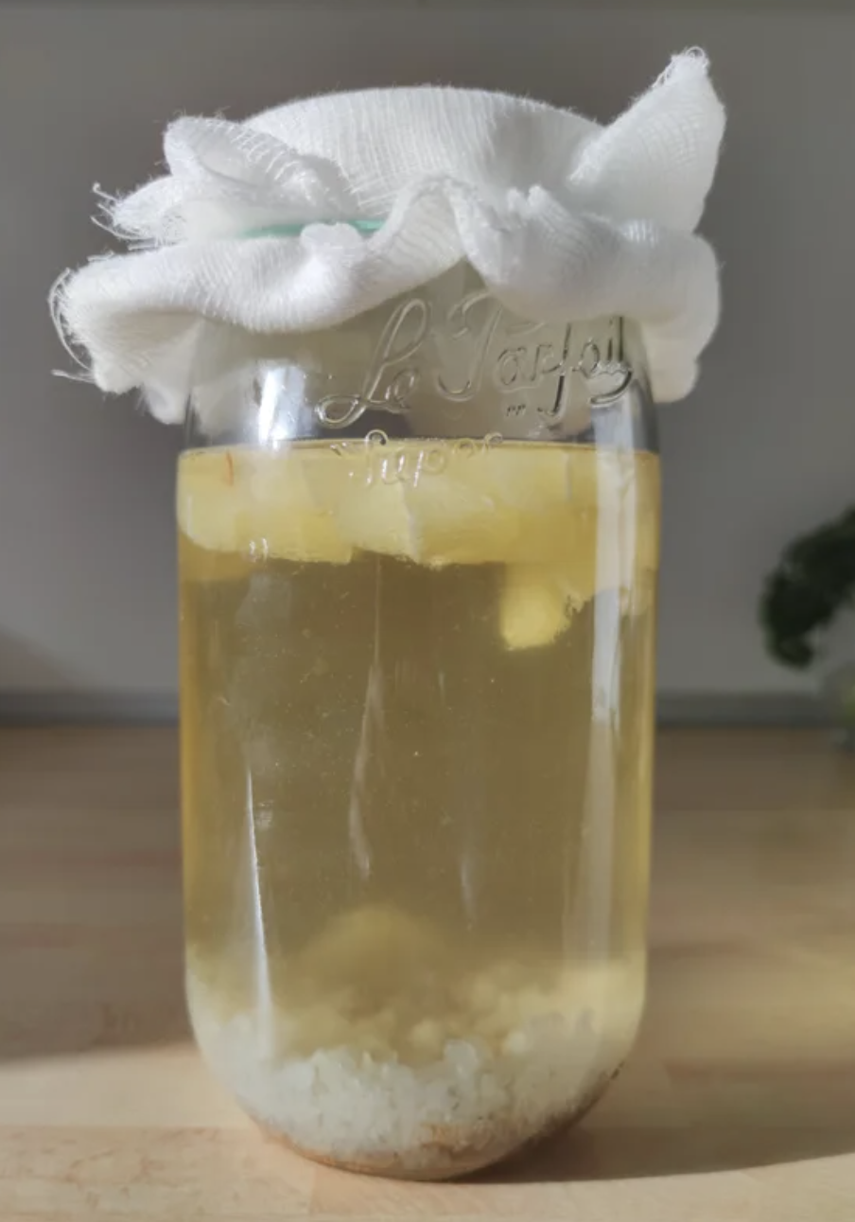
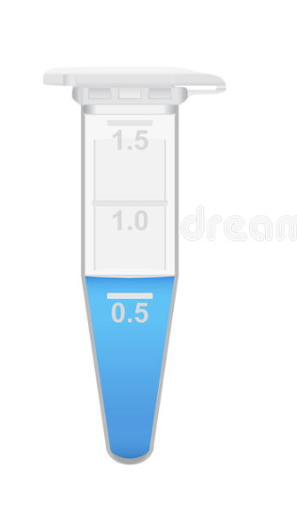
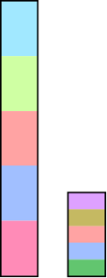
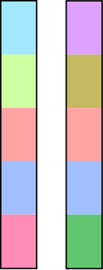
Pitfalls
The microbiota of animals
DNA ext
PCR
Library prep.
Equimolar concent.
counts
%

Slide 9

Pitfalls
The microbiota of animals
😊
counts
%
😊
😊
Normalize again with some measure of absolute abundance:
qPCR
FlowCyto
FISH
counts
😊

Slide 10
The microbiota of animals
Scales of
Diversity

Slide 11
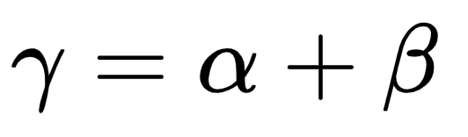
Scales of Diversity
The microbiota of animals
Biodiversity is a measure of the magnitude of genetic, species and ecological variation in an ecosystem.

Slide 12
Scales of Diversity
The microbiota of animals
…the local variation contained in each site or sample, or Alpha diversity…

Slide 13
Scales of Diversity
The microbiota of animals
… and the degree of dissimilarity between sites (turnover), known as Beta diversity…

Slide 14
Scales of Diversity
The microbiota of animals
Gamma diversity is the total, regional diversity in a landscape and consists of two components…

Slide 15
The microbiota of animals
Alpha
Diversity

Slide 16
The microbiota of animals
Alpha Diversity
 |  |  | 250 | 100
 | 70 | 100 | 200 | 50
 | 4 | 100 | 250 | 600
 |  | 100 | 225 | 200
 | 20 | 100 | 200 | 50
Obs | 3 | 4 | 5 | 5
Observed Richness:
How many species, ASVs or OTUs do we observed in each sample?
Gives NO weight to abundance

Slide 17
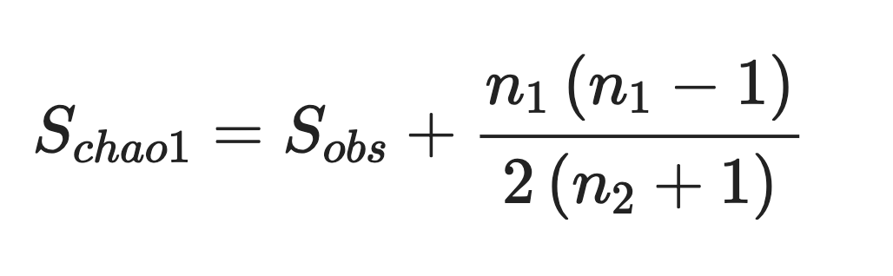
The microbiota of animals
Alpha Diversity: Richness estimators
 |  |  | 250 | 100
 | 70 | 100 | 200 | 50
 | 4 | 100 | 250 | 600
 |  | 100 | 225 | 200
 | 20 | 100 | 200 | 50
Obs | 3 | 4 | 5 | 5
How many more species are we expected to see?
The DADA2 and OUT clustering approaches both eliminate singletons from your samples.
Singletons are the hardest to differentiate from errors
Calculate the ratio of OTUs occurring only once (singletons, n1), to those occurring twice (doubletons, n2)
Gives NO weight to abundance

Slide 18
Alpha Diversity: Rarefaction
The microbiota of animals
How do I standardize unequal sampling sizes for comparison?
Reads sampled
Sample

Slide 19
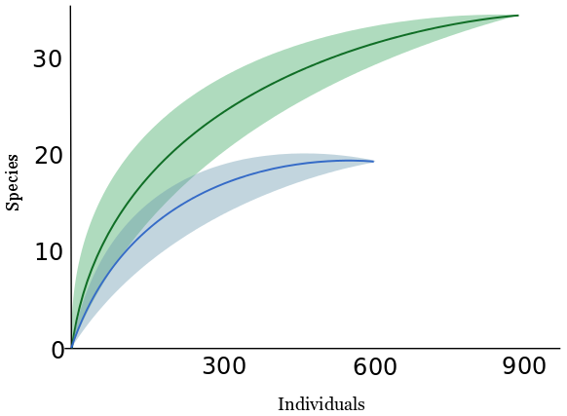
Alpha Diversity: Rarefaction
The microbiota of animals
E(x)
How many OTUs would I expect to see E(x) if I had only sampled n reads?
OTUs / ASVs / Species
Individuals / Reads / Cell counts

Slide 20
Alpha Diversity: Rarefaction
The microbiota of animals
How many OTUs would I expect to see E(x) if I had only sampled n reads?
E(x)
If I keep finding new OTUs with every x reads sampled, then I am missing OTUs from my sample
OTUs / ASVs / Species
Individuals / Reads / Cell counts

Slide 21
Alpha Diversity: Rarefaction
The microbiota of animals
How many OTUs would I expect to see E(x) if I had only sampled n reads?
E(x)
I can standardize richness if I compare at the same sampling depth, with subsampled (rarefied) datasets!
OTUs / ASVs / Species
Individuals / Reads / Cell counts

Slide 22
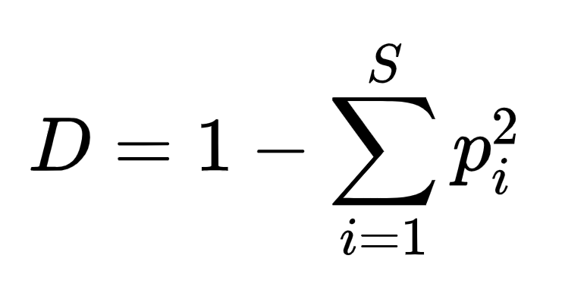
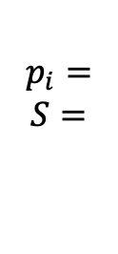
Alpha Diversity: Evenness
The microbiota of animals
 |  |  | 250 | 100
 | 70 | 100 | 200 | 50
 | 4 | 100 | 250 | 600
 |  | 100 | 225 | 200
 | 20 | 100 | 200 | 50
D | 0.60 | 0.25 | 0.20 | 0.42
Simpson’s Index:
What is the probability that two individuals sampled at random belong to the same species?
$$\begin{aligned} \\ p_{i}= \\ S= \\ \end{aligned}$$
Proportion of ith species
Total number of species
Gives more weight to abundance

Slide 23
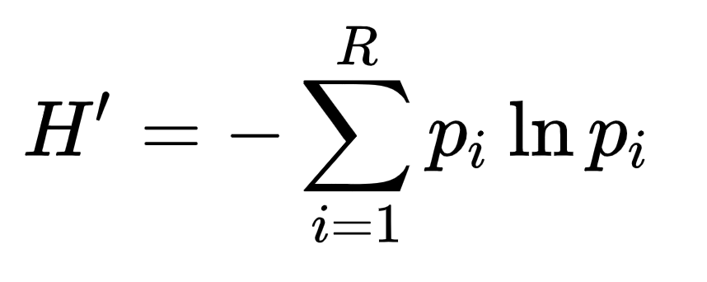
Alpha Diversity: Evenness
The microbiota of animals
 |  |  | 250 | 100
 | 70 | 100 | 200 | 50
 | 4 | 100 | 250 | 600
 |  | 100 | 225 | 200
 | 20 | 100 | 200 | 50
H’ | 0.68 | 1.39 | 1.60 | 1.16
Shannon’s Information Index:
Amount of information needed to describe a community.
It is a measure of the uncertainty in predicting relative abundance.
Gives EQUAL weight to
abundance and richness

Slide 24
Beta Diversity
The microbiota of animals
Beta diversity is often measured in coefficients of dissimilarity or distances, to represent how different communities are in terms of composition or structure.
Few Shared OTUs
High Beta Diversity
Low Similarity
Many Shared OTUs
Low Beta Diversity
High Similarity

Slide 25
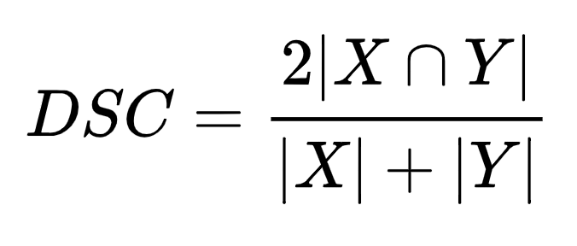
The microbiota of animals
Beta Diversity: Sorensen-Dice Index
 | 1 | 0.7 | 0.4 | 0.4
 | 0.7 | 1 | 0.8 | 0.8
 | 0.4 | 0.8 | 1 | 1
 | 0.4 | 0.8 | 1 | 1
What is the proportion of shared OTUs from the total OTUs in both communities?
X
Y

Slide 26
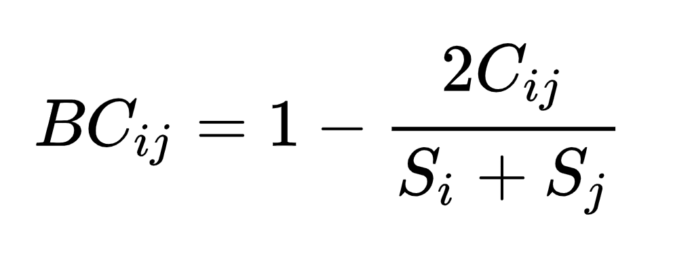
The microbiota of animals
Beta Diversity: Bray-Curtis distance
 |  |  | 250 | 100
 | 70 | 100 | 200 | 50
 | 4 | 100 | 250 | 600
 |  | 100 | 225 | 200
 | 20 | 100 | 200 | 50
Incorporates abundances (counts) to the Sorensen-Dice index
C_{ij} = Sum of the lesser values of
the shared species
S_{x} = Total species in S_{x}
= 0.38

Slide 27
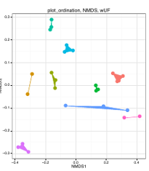
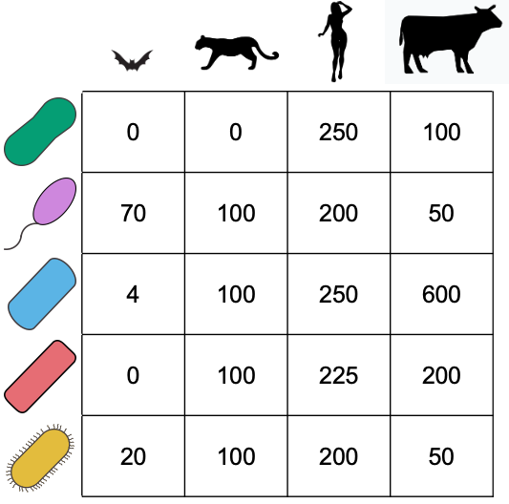
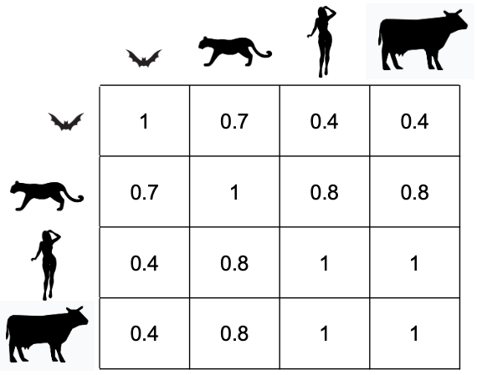
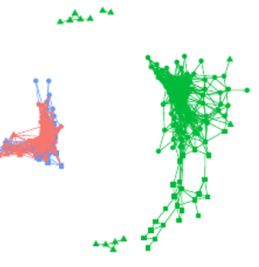
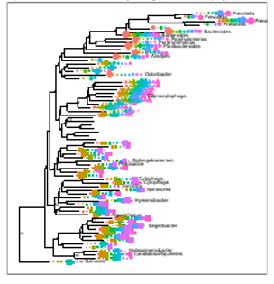
Beta Diversity : Ordinations
The microbiota of animals
Dissimilarity Matrices are multidimensional, and need multivariate statistics to test and project:
Ordination
Plots
Species
Matrix
Distance
Matrix
Networks
Clusters

Slide 28
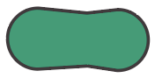
Beta Diversity : Ordinations
The microbiota of animals
1-Dimension
0
0
50
100

Slide 29

Beta Diversity : Ordinations
The microbiota of animals
2-Dimensions
100
50
0
0
50
100

Slide 30

Beta Diversity : Ordinations
The microbiota of animals
3-Dimensions
100
50
0
50
100
50
100

Slide 31
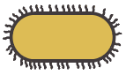
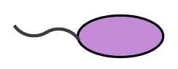
Beta Diversity : Ordinations
The microbiota of animals
n-Dimensions
100
50
0
50
100
50
100

Slide 32

Beta Diversity : Ordinations
The microbiota of animals
n-Dimensions

Slide 33
limitations of 16SrRNA

Slide 34
Our topic: Water kefir microbiota
Water kefir: A fermented, fizzy drink
Lactic acid bacteria
Acetic acid bacteria
Yeasts
Sugars
Fermentation
Acids, alcohol
https://revolutionfermentation.com/

Slide 35
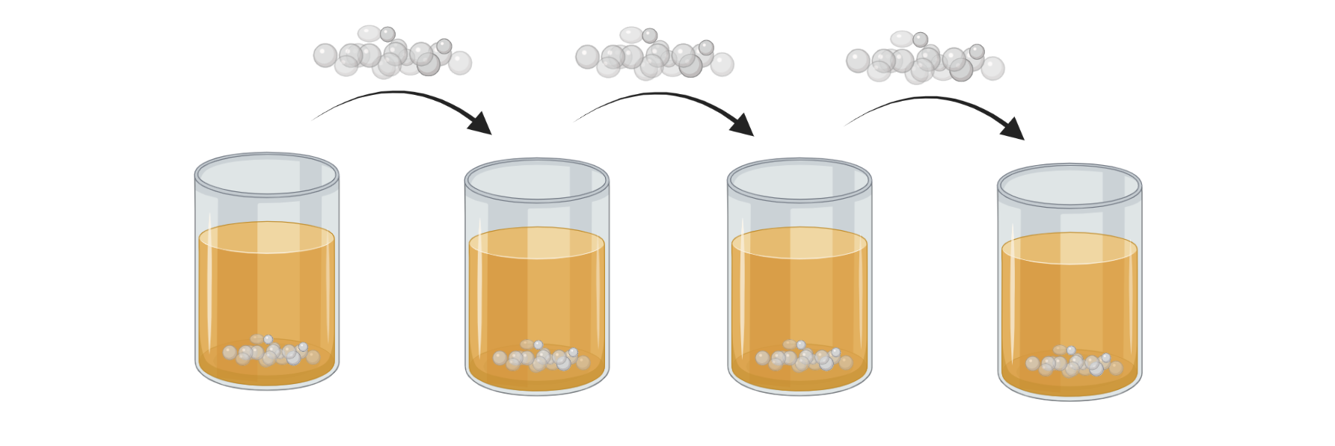
Origin of communities of fermented foods
The microbiota of animals
Wild/spontaneous fermentation
Starter culture-based fermentation
Starter cultures of fermented foods are serial passaged
Kombucha biofilm
Water kefir
Milk kefir

Slide 36
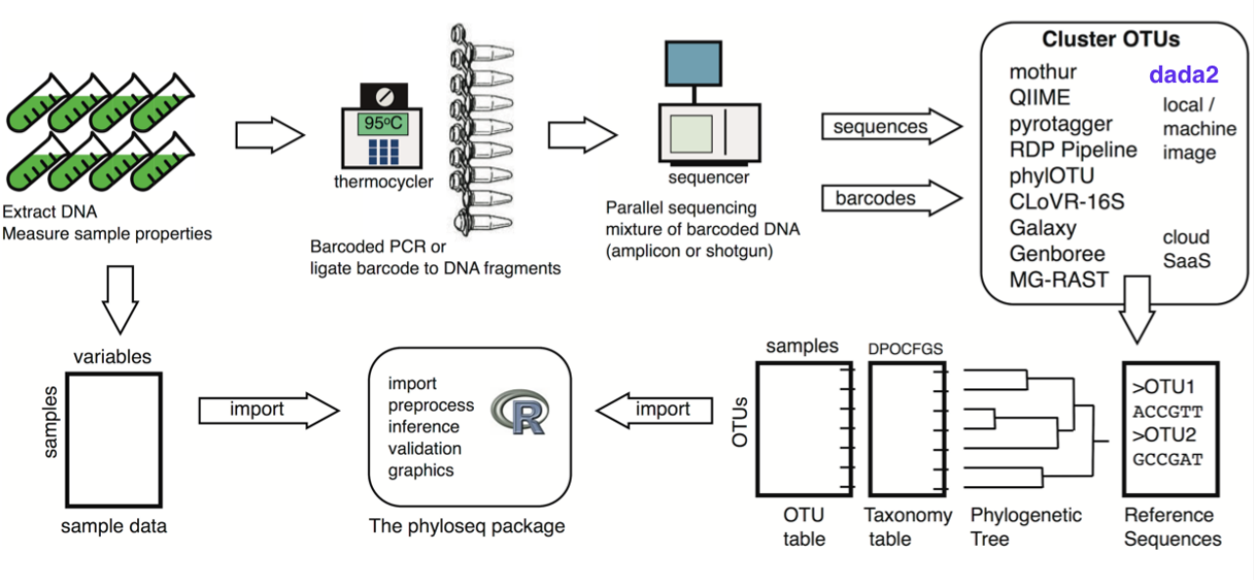
PHYLOSEQ

Slide 37
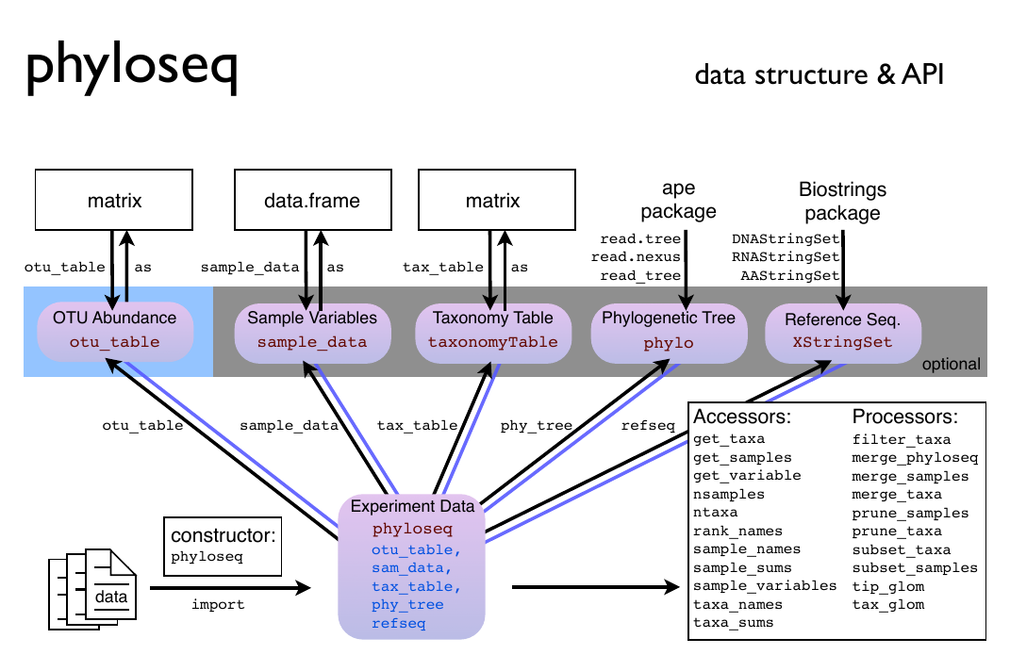
PHYLOSEQ

Slide 38
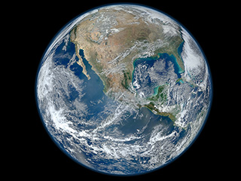
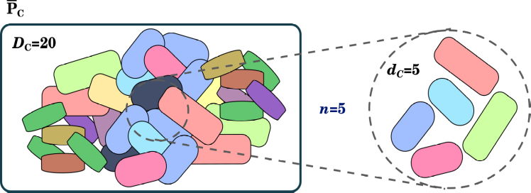
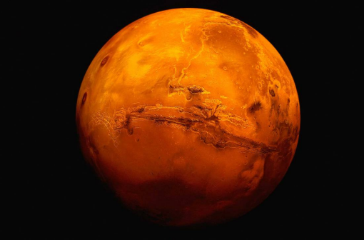
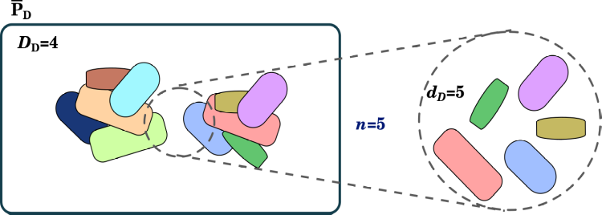
limitations of 16SrRNA
counts
%

Slide 39
Sample representatively!
counts
%

Slide 40
limitations of 16SrRNA
%

Slide 41
limitations of 16SrRNA
Output read number limited by the instrument
Equimolar
concentrations
%
1. Total abundance info is lost in two steps

Slide 42
limitations of 16SrRNA
Output read number limited by the instrument
Equimolar
concentrations
%
1. Total abundance info is lost in two steps
2. Read count cannot be related to the total molecules in the sample

Slide 43
limitations of 16SrRNA
Output read number limited by the instrument
Equimolar
concentrations
%
1. Total abundance info is lost in two steps
2. Read count cannot be related to the total molecules in the sample
3. Final read counts contain ONLY information about ratios (proportions)

Slide 44
limitations of 16SrRNA
High-throughput Sequencing
Data is Compositional
Output read number limited by the instrument
Equimolar
concentrations
%
1. Total abundance info is lost in two steps
2. Read count cannot be related to the total molecules in the sample
3. Final read counts contain information about ratios (proportions)

Slide 45
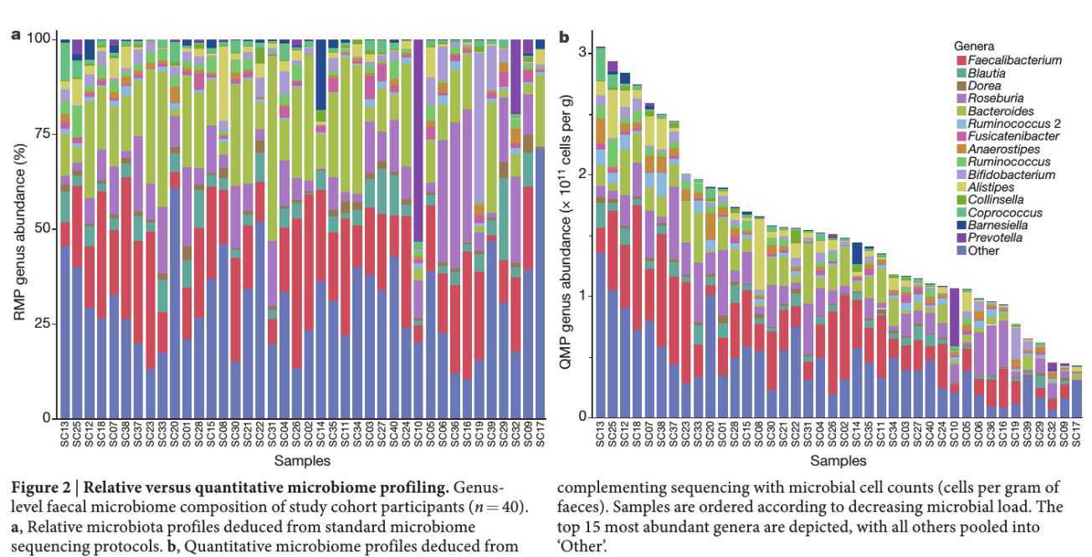
limitations of 16SrRNA
By using relative abundances we lose very relevant information about total abundances → biomass
Vandeputte et al. 2017

Slide 46
limitations of 16SrRNA
counts
%
Always keep a reference measure of the total cell/DNA/amplicons density in your sample!
By using relative abundances we lose very relevant information about total abundances → biomass
Vandeputte et al. 2017

Slide 47
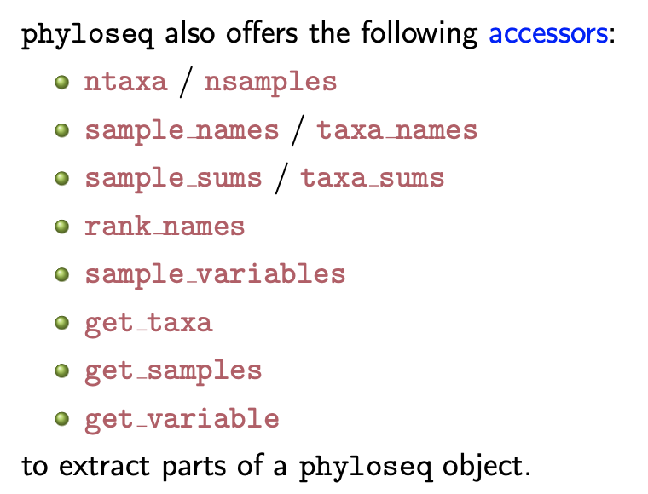

Slide 48
1. Comparing samples: Rarefaction
3. Focal diversity (Alpha)
4. Heterogeneity (Beta)
5. What are we measuring with our reads?

Slide 49
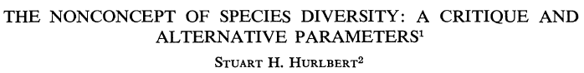
Understanding Diversity
“The term 'species diversity' has been defined in such various and disparate ways that it now conveys no information other than 'something to do with community structure'; species diversity has become a nonconcept.”
“Communities having different species compositions are not intrinsically arrangeable in linear order on a diversity scale. Diversity per se does not exist.”

Slide 50
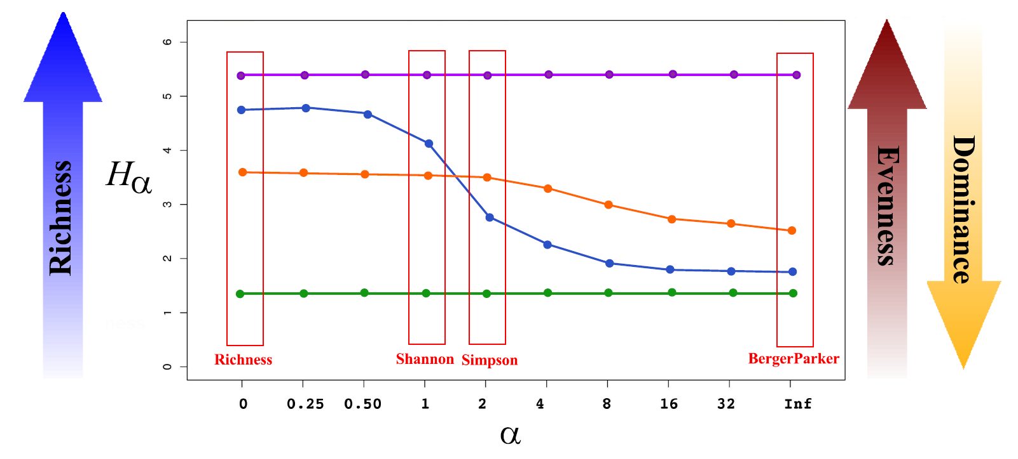
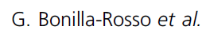
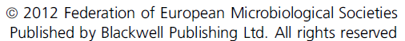
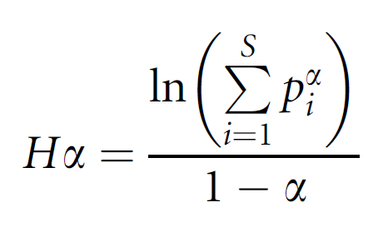
α = scale parameter
p_{i} = relative abundance of ith species

Slide 51
Renyi's Entropy
$$H_{α}=\frac{ln\left(\sum_{i=1}^{s}{p_{i}^{α }}\right)}{1−α}$$
$$H_{\left(0\right)} = ln\left(\sum_{i=1}^{s}{1}\right)$$
→ Richness
$$\lim_{α→1}{H_{\left(α\right)}}= −\sum_{i=1}^{S}{p_{i}\text{ln}p_{i}}$$
→ Shannon
$$H_{\left(2\right)} = ln\left(\sum_{i=1}^{s}{p_{i}^{2}}\right)$$
→ Simpson
$$\lim_{α→∞}{H_{\left(α\right)}}= ln\left(p_{max}\right)$$
→ Berger-Parker

